Slide 1

DATA ANALYTICS LEVEL 2 PROJECT
OIBSIP Repository
Credit Card Fraud Detection Analysis
Exploratory Data Analysis, Model Diagnostics, and Feature Importance Evaluation
EDA & Diagnostics
ML Classifiers
Fraud Mitigations
6-Slide Overview

Slide 2


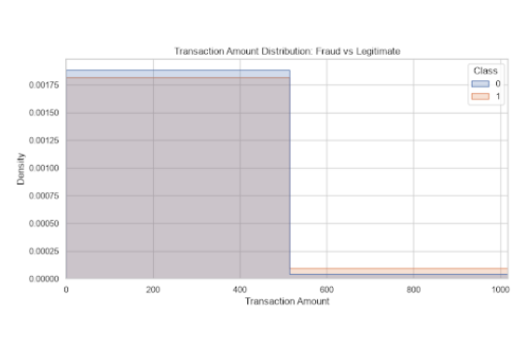
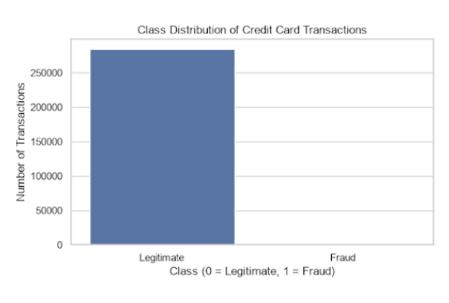
DATA PROFILE & IMBALANCE
Slide 02
Class Distribution & Transaction Amounts
Extreme Imbalance
Low Value Clustering
Fraud cases form an extreme minority relative to legitimate volume.
Fraudulent and genuine transactions heavily aggregate at lower monetary values.

Slide 3
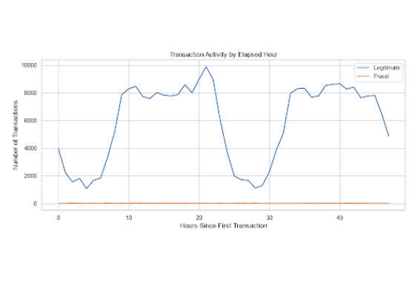
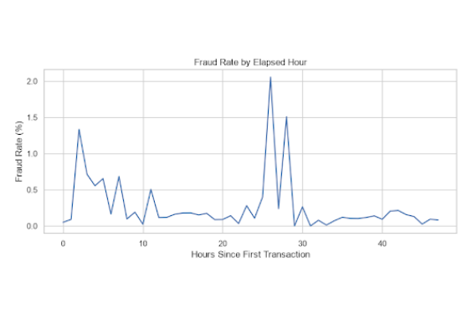
TIME-SERIES INSIGHTS
Slide 03
Activity Dynamics vs Fraud Rate Spikes
24-Hour Diurnal Cyclicality
Off-Peak Risk Concentration
Legitimate volume displays predictable daily periodic waves.
Fraud percentage spikes dramatically (>2%) during low-traffic sleeping hours.

Slide 4
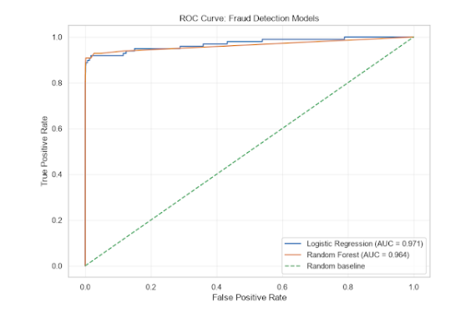
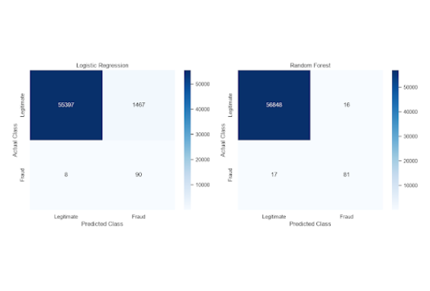
MODEL EVALUATION
Slide 04
ROC Curves & Confusion Matrix Diagnostics
High Discrimination Ability
False Positive Reduction
Logistic Regression (AUC 0.971) and Random Forest (AUC 0.964) both excel.
Random Forest drastically suppresses false alarms (16 vs 1,467 cases).

Slide 5

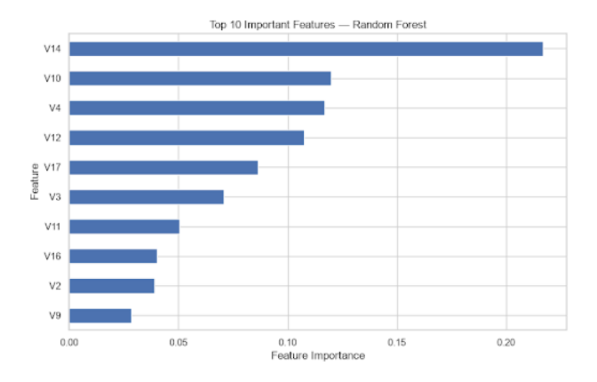
FEATURE IMPORTANCE
Slide 05
Top 10 Feature Importances (Random Forest)
Primary Driver: V14
V14 carries overwhelmingly heavy weight (>0.21 importance), acting as the central decision pivot for detecting anomalies.
Core PCA Factors
Transformed features V10, V4, V12, and V17 represent secondary decision nodes crucial for classifying subtle fraud patterns.

Slide 6

SUMMARY & NEXT STEPS
Strategic Recommendations
Deploy Random Forest
Dynamic Risk Thresholds
Provides superior operational precision with only 16 false positives, preventing user friction while maintaining high recall.
Apply stricter time-sensitive risk scoring during off-peak morning hours when fraud rates spike above 2%.
Credit Card Fraud Detection Analysis
End of Presentation

